Slide 1
Predicting an Individual’s Risk of Heart Disease Using Various Machine Learning Models
Phuong Vu, Yunwei Liang, Trinh Nguyen

Slide 2
Motivation & Background
Our Why
Heart disease is the leading cause of death worldwide.
Use for common diagnosis
Alleviate financial burdens from diagnosis tests
Help generate preventative care plans
From 2014 to 2015,
$219 billion are lost due to the cost of
healthcare services, medicines, and lost productivity due to death related to heart disease.

Slide 3
Research Questions
Part I
Which machine learning algorithm can best predict the risk of heart disease?
Part II
What is the correlation between each feature and the prediction of one’s risk for heart disease?
Which feature is determinant of an individual’s health risk?

Slide 4
Methodology
Part I
Prepare the dataset.
Fit the data set to each model (Decision Tree Classifier, Random Forest Classifier, Gaussian Naive Bayes Classifier) and test their performance with accuracy score.
Use the average accuracy score over 10 trials to find the most accurate model.
Part II
Using the most accurate model and the prepared dataset:
Find the correlation between each feature and the label.
Check the correlation result with an ablation study.
Remove one feature attribute from the data at a time and run the model to see how the accuracy score differ without that feature.

Slide 5
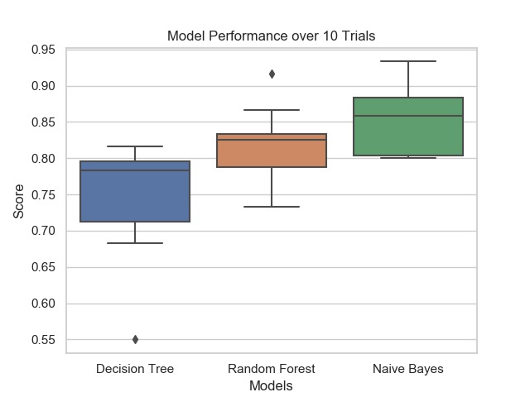
Key Results
Part I Which machine learning algorithm can best predict the risk of heart disease?
Gaussian Naive Bayes Classifier is the most accurate
Random Forest Classifier
Decision Tree Classifier
Part II What is the correlation of each feature?
The strongest correlation was 0.527, between “thal” and “prediction”
The only inverse correlation was -0.424, between “thalach” and “prediction”

Slide 6
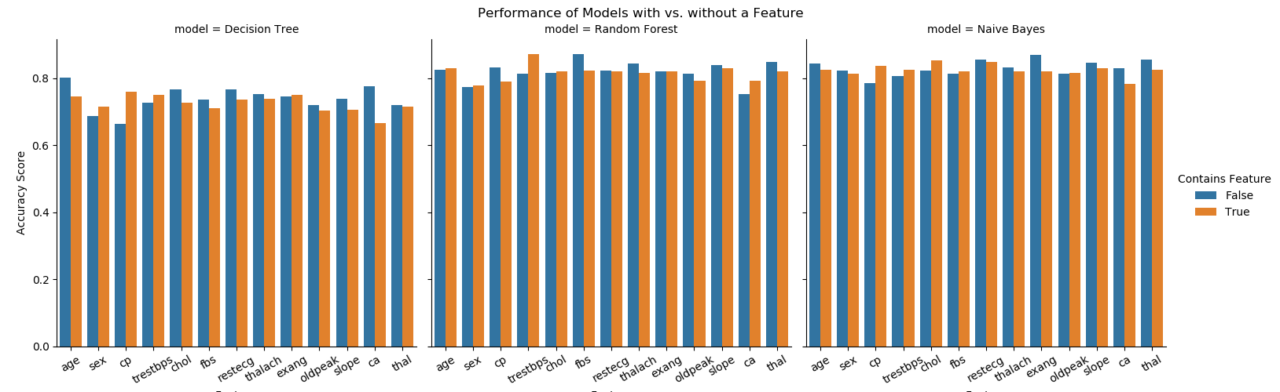
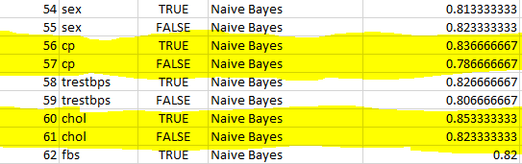
Key Results
Part II Which feature is determinant of an individual’s health risk?
From ablation study, there are no distinct feature that significantly impact the score.
In the naive bayes model, there is a highest difference of -0.0500 when “cp” was removed. Even then this is miniscule.

Slide 7
Future Work
Improve the models with ensemble techniques
Determine why the correlation found via the Pearson r coefficient does not match ablation study

Slide 8
Thank you for listening!
Please email us your questions at
nguyetri@uw.edu

